Slide 1
LEARNING – HOW TO LEARN FAST
MeuMoc

Slide 2
—VU CAT TUONG
“Discipline will drive you to a place where motivation cannot”

Slide 3
LEARNING – HOW TO LEARN FAST
I
II
III
IV
TECHNOLOGY AND LEARNING
LEARN?
WHY WE LEARN?
HOW TO LEARN

Slide 4

I
LEARN?

Slide 5
LET’S REVIEW SOME CONCEPTS
1.
3
WHAT IS “LEARN”
WHAT IS LEARN FAST?
2.
LEARN OR STUDY

Slide 6

—oxford dictionary
1. WHAT IS LEARN?
“Gain knowledge or skill by studying, from experience, from being taught”

Slide 7
2.LEARN OR STUDY
LEARN
STUDY
- GAIN KNOWLEDGE
- IN YOUR HEAD FOREVER
- GET INFORMATION
- REMEMBER INFORMATION

Slide 8

3. LEARN FAST = LEARN EFFECTIVELY
- How much knowledge do we retain
# how much information do we know
-

Slide 9

II.
WHY WE LEARN

Slide 10
WHY WE LEARN
- Intellectual and skill Development
- Increased Confidence
- Career Progression
- Adapting to Technological Challenges

Slide 11

III.HOW TO LEARN

Slide 12
HOW TO LEARN
1.
2.
THINKING
METHOD

Slide 13
1. THINKING
MINIMALISM
80-20
PARKINSON’S LAW

Slide 14

a. MINIMALISM
Prioritizing the Most Strategic Work First

Slide 15

b. 80-20
- 80% OUTPUT FROM 20% INPUT
- FIND 20% WHAT,WHY,WHEN,WHERE,HOW
-SIMULATE THAT SITUATION

Slide 16
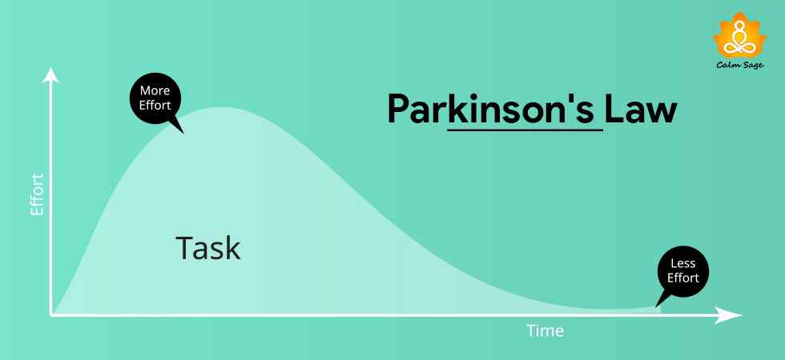
c. PARKINSON
- WORK EXPANDS TO FILL THE TIME AVAILABLE FOR IT’S COMPLETION

Slide 17
2. METHOD
ACTIVE RECALL + SPACED REPETITION
EISENHOWER MATRIX + M.I.T
RELEVANCE
TEACHING TO LEARN
BATCHING
BE PRESENT

Slide 18
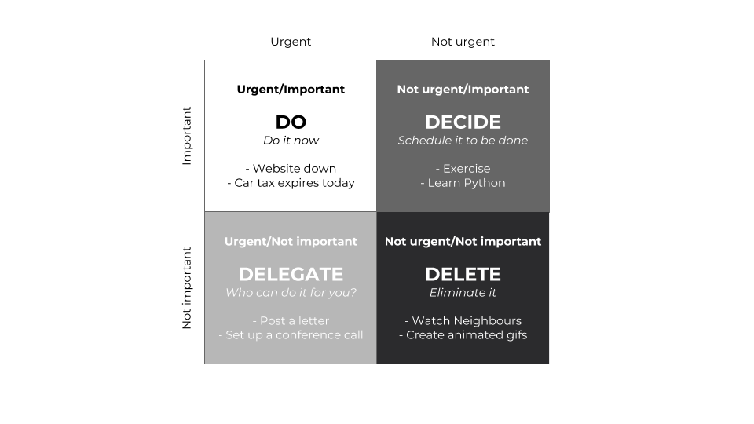
a. EISENHOWER MATRIX + M.I.T
1-3 MOST IMPORTANT TASKS/DAY

Slide 19

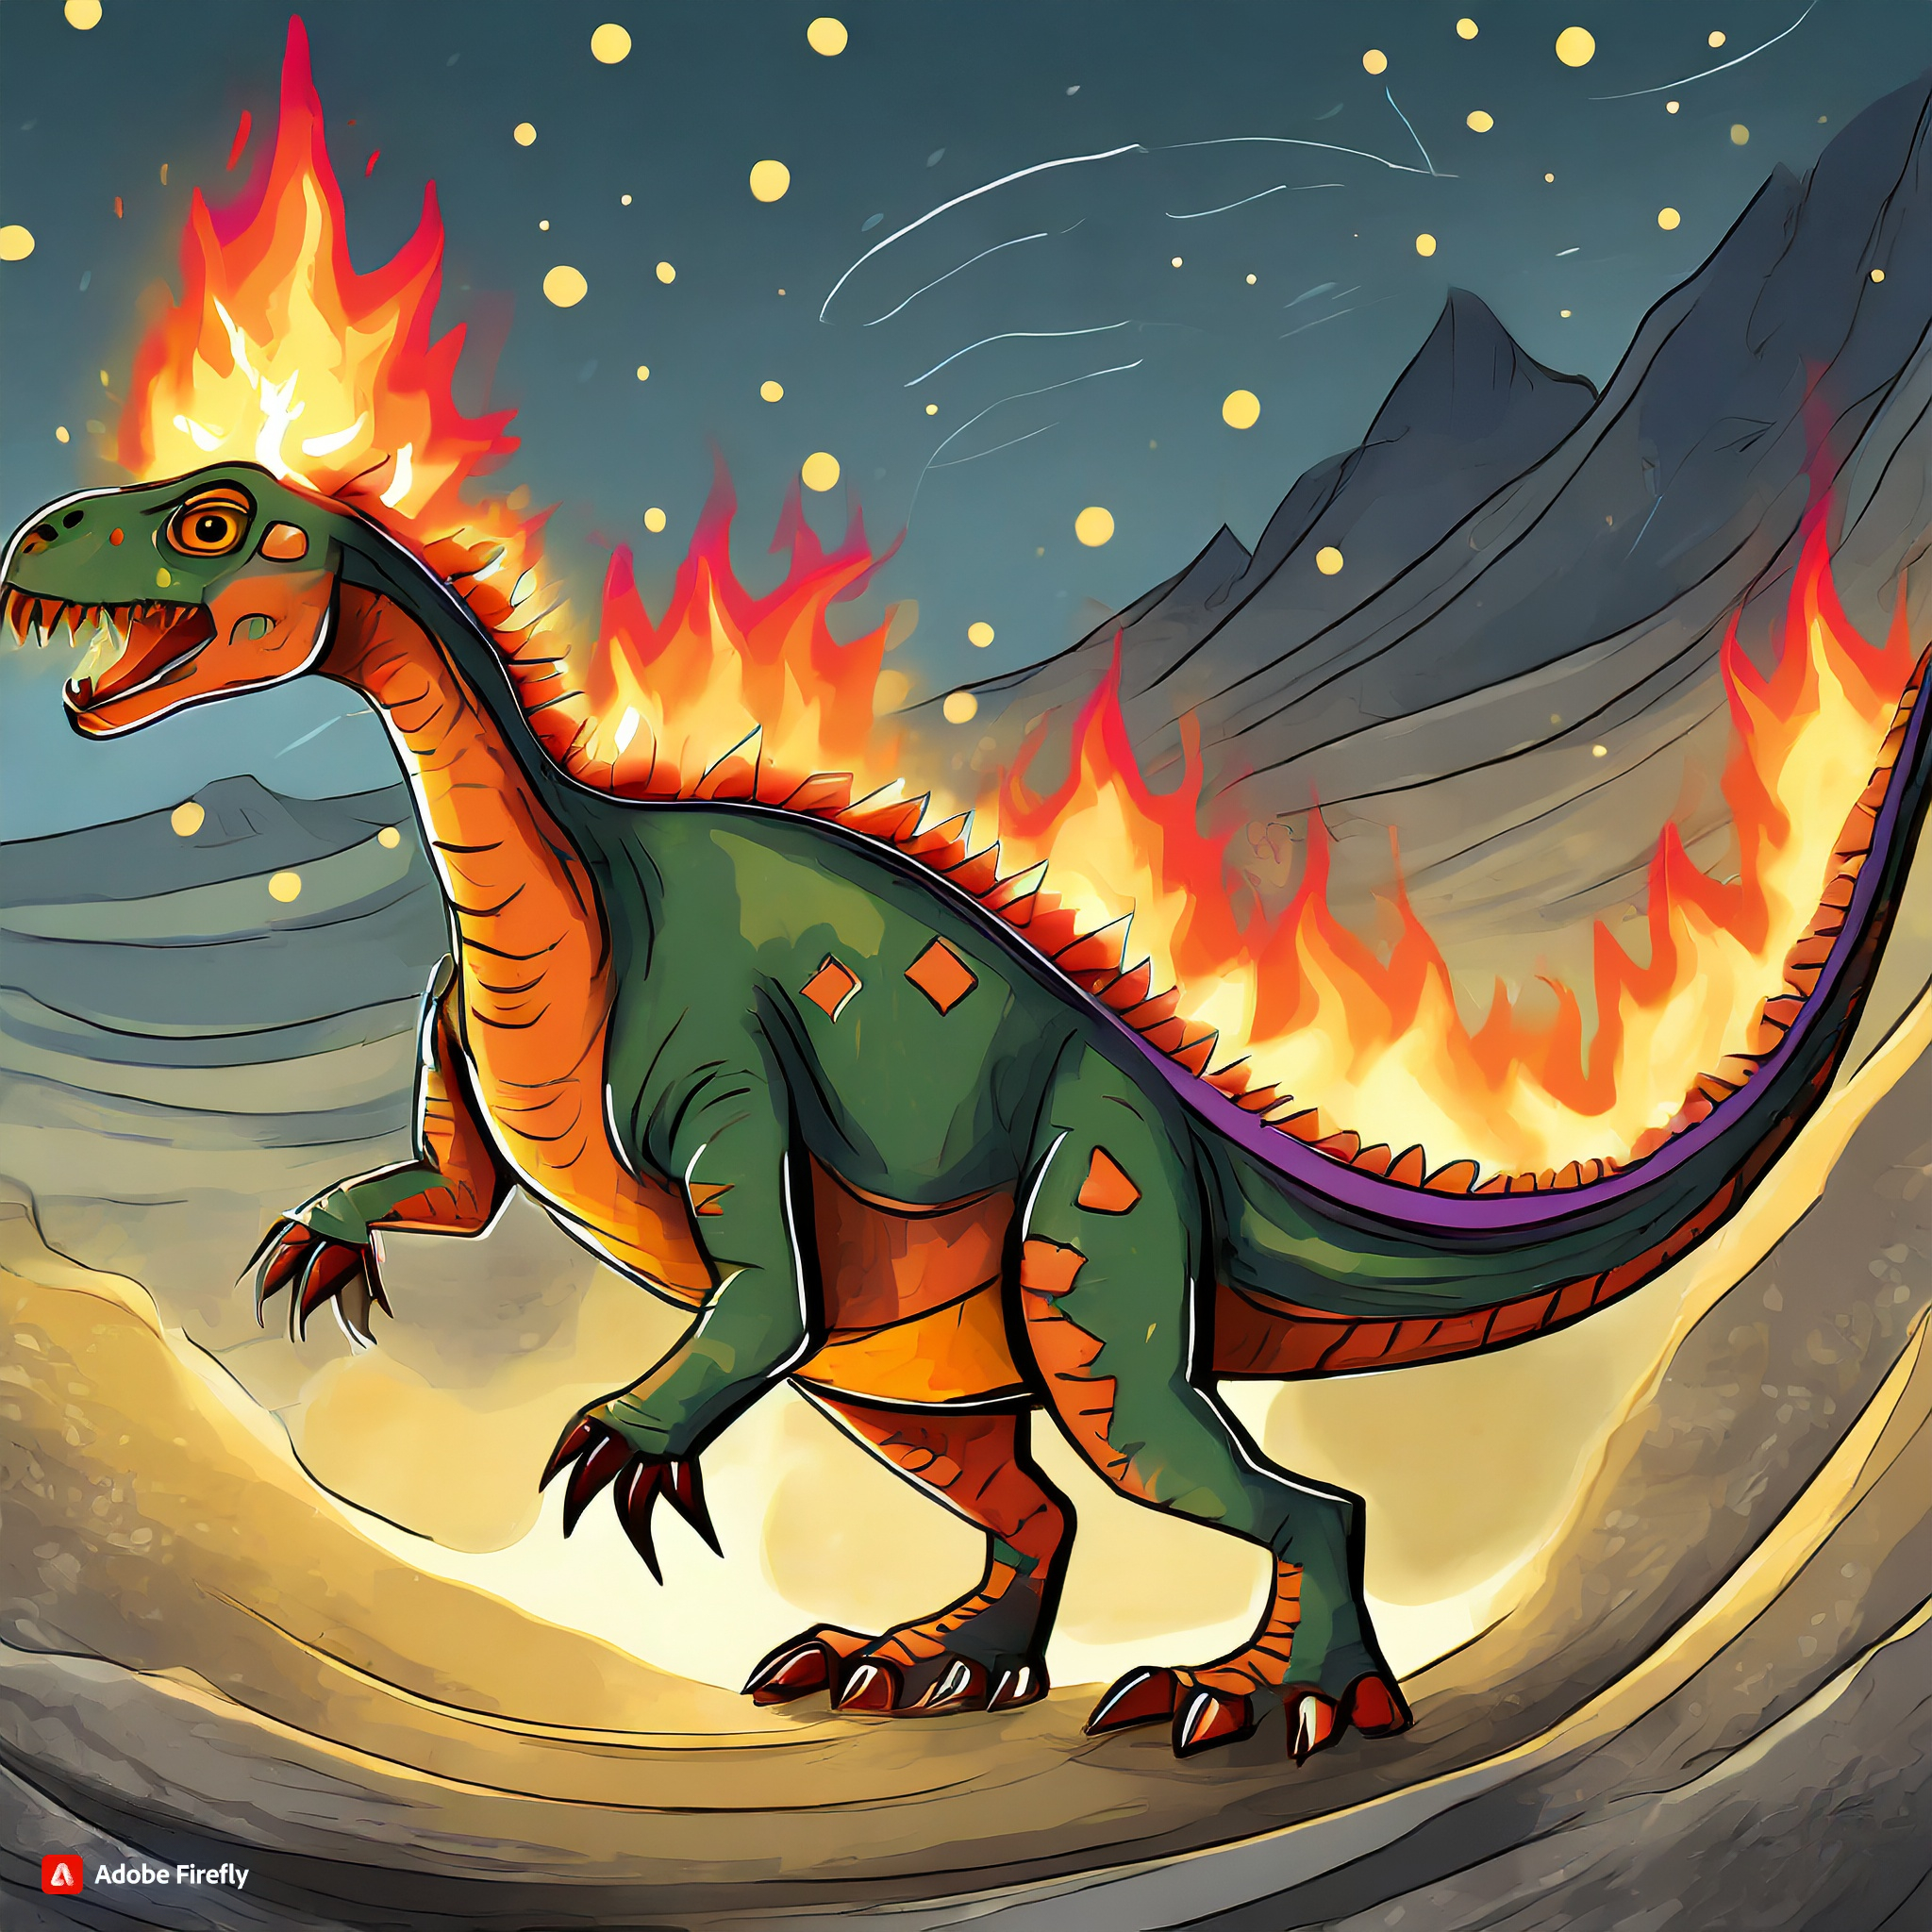
b. RELEVANCE
- RESEARCH
- SCAN KEYWORD
- PREDICTION DEFINITION
- LOOK UP CORRECT MEANING

Slide 20

c. BATCHING
Grouping similar tasks completing in a single session

Slide 21
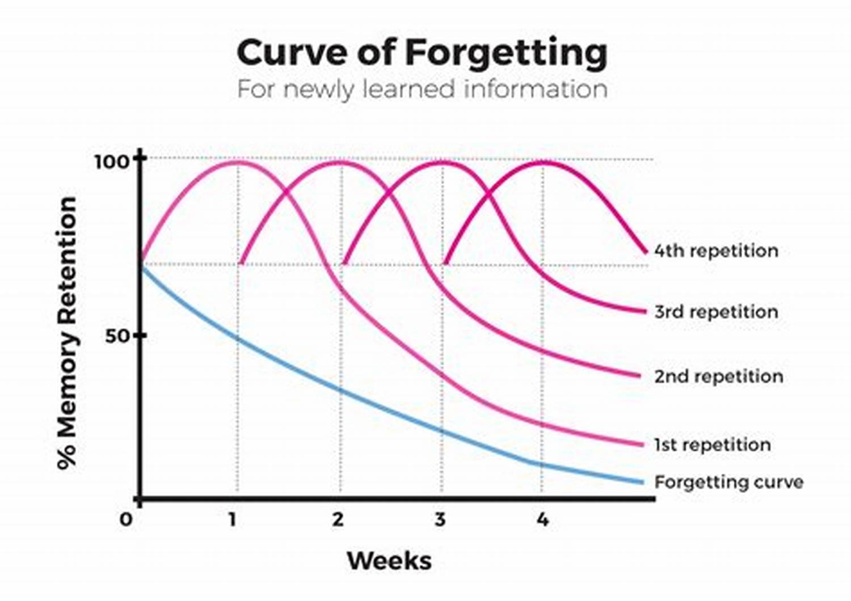
d. ACTIVE RECALL + SPACED REPETITION
- Retrieve Information
- Self-Testing
- Frequent Practice
- Feedback

Slide 22

e. TEACHING TO LEARN
- Deeper Understanding
- Clarification of Concept
- Identification of Knowledge Gaps
- Application of Knowledge

Slide 23

f. BE PRESENT
100% WORK 100% LIFE

Slide 24
IV.TECHNOLOGY AND LEARNING

Slide 25
CHAT-GPT
XMIND
GITHUB COPILOT

Slide 26

CHAT-GPT

Slide 27

XMIND

Slide 28

CHAT-GPT

Slide 29
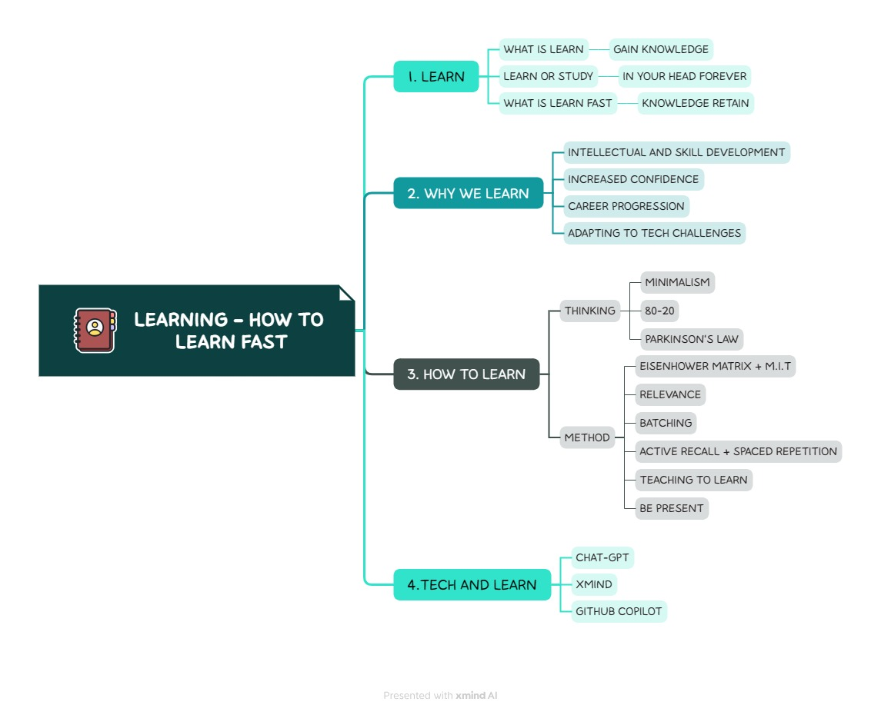
CONCLUSION

Slide 30
CREDIT
CHI NGUYEN - Ph.D. Educational Leadership and Comparative & International Education

Slide 31

THANKS FOR READING
MEUMOC~~~~~~~

